Slide 1
Developing Apps for Touch and Mobile Devices

Slide 2
Objectives
In this session, you will learn to:
  Develop apps for the Windows Phone 8.1 platform
  Port an existing Windows app to a Windows Phone

Slide 3
Task 6.1: Creating a New Windows Phone Project

Slide 4
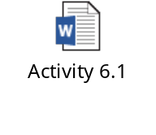
Activity 6.1: Developing Your First Windows Phone App
Problem Statement:
Solution:
To complete this activity, you need to perform the following steps:
  Create a blank Windows Phone app.
  Add UI elements to the app interface.
  Create and register the event handler.
  Execute the app and verify the output.

Slide 5

UI Controls in a Windows Phone App
You can use JavaScript controls for developing the UI and performing several functions in your Windows Phone apps.
The controls that are available to Windows Store apps but not available to Windows Phone apps are shown in the following figure.
The following new controls have been introduced in the WinJS
library for Windows Phone 8.1:
  Pivot: Creates a container control that can hold multiple items.
  Pivot item: Creates items for pivot container control.
Menu
Tooltip
Menu command
Controls supported by Windows Store apps but not by Windows Phone apps
Settings flyout
Back button
Flyout

Slide 6
WinJS API Changes for Windows Phone 8.1
The following table shows the API changes introduced for controls in the Windows Phone 8.1 platform.
Controls | Description
AppBar and AppBarCommand controls | Most of the features of AppBar and AppBarCommand are also available on Windows Phone 8.1.
Flyout | This control is not supported in Windows Phone 8.1. Instead of this control, you can use PopupMenu to create a context menu for a Windows Phone app.
SettingsFlyout | This control is not supported in Windows Phone 8.1. Instead of this control, you can either navigate to a new page or use the Windows.UI.Popup context menus.
DatePicker and TimePicker controls | These controls are not supported in Windows Phone 8.1. Instead of these controls, you can use the HTML elements, SELECT and OPTION.
Hub | The hub control is used in the Windows Store apps to create a hub navigation that can hold multiple sections.

Slide 7
WinJS API Changes for Windows Phone 8.1 (Contd.)
The following new objects have been added to WinJS API for Windows Phone 8.1:
  WinJS.UI.Pivot: Displays multiple items on a tab control
  WinJS.UI.PivotItem : Creates a new item in the Pivot control
The following new members are added to the existing objects and namespaces of the WinJS library.
Members | Description
WinJS.Application. onbackclick event | This event is raised when the user clicks the Back button on a Windows Phone device.
WinJS.Utilities.isPhone property | This property checks the device on which the app is running. It returns True, if the app is running on the Windows Phone device, otherwise returns False.
WinJS.UI.AppBar.closedDisplayMode property | This property specifies or retrieves how the app bar appears when the hidden property is set to true. This property can hold the following values: Compact Minimal

Slide 8
WinJS API Changes for Windows Phone 8.1 (Contd.)
The following table shows the important members that are not supported on the Windows Phone platform.
Members | Description
WinJS.UI.Application.onsettings event | In a Windows app, this event is raised when the setting charm is invoked. In the Windows Phone 8.1 app, this event is ignored.
WinJS.UI.AppBar.layout property | This property is ignored in Windows Phone 8.1.
WinJS.UI.AppBarCommand.flyout property | This property is ignored in Windows Phone 8.1.
WinJS.UI.AppBarCommand.lastElementFocus property | This property is ignored in Windows Phone 8.1.
WinJS.UI.AppBarCommand.firstElementFocus property | This property is ignored in Windows Phone 8.1.

Slide 9
WinJS API Changes for Windows Phone 8.1 (Contd.)
The following table shows the important members whose behaviors differ on Windows and the Windows Phone platform.
Members | Description
WinJS.UI.AppBar.hide() method | Hides the secondary command menu on Windows Phone. On the Windows platform, this method hides the app bar.
WinJS.UI.AppBar.show() method | Displays the secondary command menu on Windows Phone in case the app bar is not disabled. On Windows, this method displays the app bar.

Slide 10

Activity 6.2: Managing State in a Windows Phone App
Problem Statement:
Solution:
To complete this activity, you need to perform the following steps:
  Create a navigation Windows Phone app.
  Save task details to App data.
  Save input field values to session data.
  Delete tasks from app data.
  Restore app data.
  Execute the app and verify the output.

Slide 11

Just a Minute
Which one of the following controls will you use to implement the functionality of the Flyout control on Windows Phone?
SettingsFlyout
Hub
PopupMenu
AppBar
Answer:
PopupMenu

Slide 12
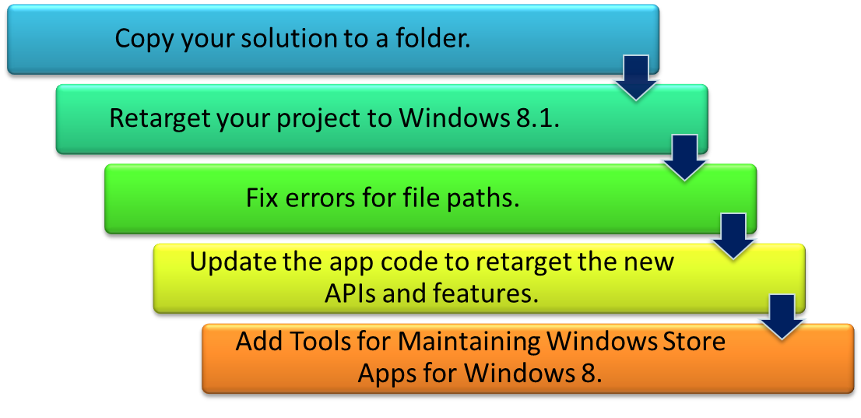
Migrating the Windows 8 App to Windows 8.1
To leverage new features and capabilities of Windows 8.1, you can retarget your Windows 8 apps to the Windows 8.1 platform.
If you have an existing Windows Store app and want to update it for Windows 8.1, you need to perform the following steps:

Slide 13
Task 6.2: Retargeting a Windows 8 App to Windows 8.1

Slide 14

Task 6.3: Adding Tools for Maintaining Store Apps for Windows 8

Slide 15
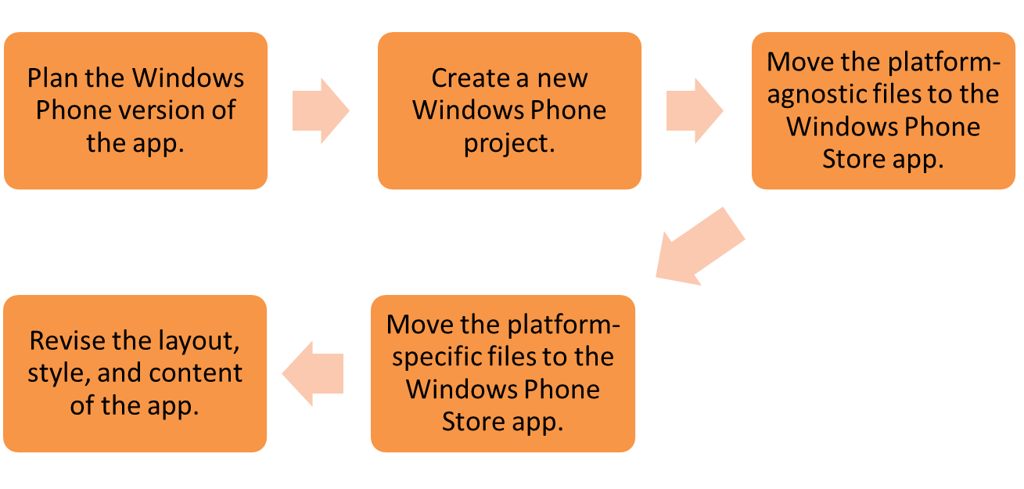
Porting the Windows 8.1 App to Windows Phone 8.1
You can port an app from Windows 8.1 to Windows Phone 8.1 by creating a new project in Visual Studio with the Windows Phone template.
You can reuse the existing application code in a new Windows Phone project.
The steps for upgrading a Windows Store app to a Windows Phone app are:

Slide 16
Porting the Windows 8.1 App to Windows Phone 8.1 (Contd.)
Planning the Windows Phone Version of the App
You can categorize the content of your app in the following types:
Content, layout, and form factors
Data, resource, and business logic
  Includes HTML pages, CSS files, and UI elements.
  Components in this category require modifications so that they can fit to the Windows Phone form factor.
  Includes data, resources, and business logic of the applications.
  Components of this category require no or least changes.
In case of a single page Windows app without any navigation, you can easily reuse the HTML page without many changes.
If you are using multiple pages with a navigation control, you need to implement a different navigation scheme by using the JavaScript code.
If you are using the hub control for navigation on Windows app,
you can use the Pivot control for implementing navigation on your Windows Phone app.

Slide 17
Porting the Windows 8.1 App to Windows Phone 8.1 (Contd.)
Create a New Windows Phone Project
If you want to port a single-page app, you can use a Blank template.
You can use the Navigation template to implement advance navigation features.
If you are porting a Hub windows app, select the Pivot project template.

Slide 18
Porting the Windows 8.1 App to Windows Phone 8.1 (Contd.)
Moving Platform-Agnostic Files to the Windows Phone Store App
You can use several files of the Windows apps without making any modification.
You can copy these files from your Windows project to the Windows Phone project.
Some examples of such files are XML documents, pure JavaScript files, visual assets, resources, and HTML files/fragments that do not use WinJS controls.
To integrate the files with your app, you need to add reference of the JavaScript and CSS files to the HTML files in your app.
You also need to add reference of the visual assets to your app by using the Visual Assets tab in the package.appxmanifest file.

Slide 19
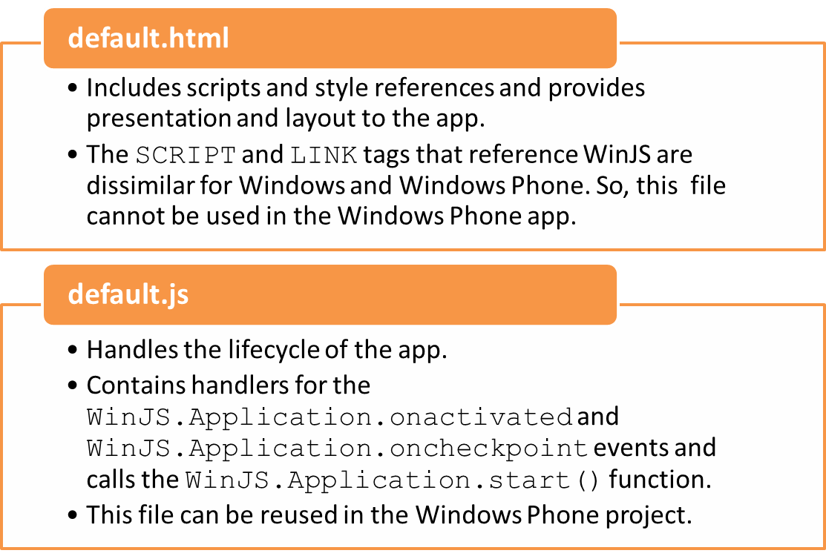
Porting the Windows 8.1 App to Windows Phone 8.1 (Contd.)
Moving Platform-Specific Files to Windows Phone Store
The default.html and default.js files provide basic structure to your app in a Windows Phone project.

Slide 20
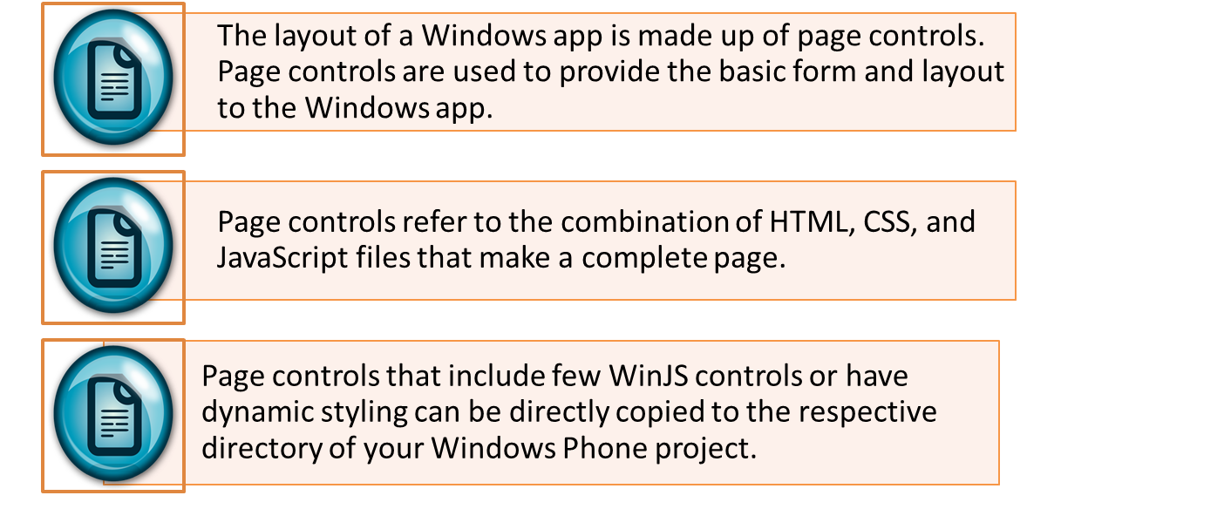
Porting the Windows 8.1 App to Windows Phone 8.1 (Contd.)
Revising Layout, Style, and Content of the App
While porting Windows apps that use page controls to a Windows Phone, you need to take care of the features and controls that are supported on the Windows Phone.
You need to handle the form factor and layout that the apps
have been designed for.

Slide 21
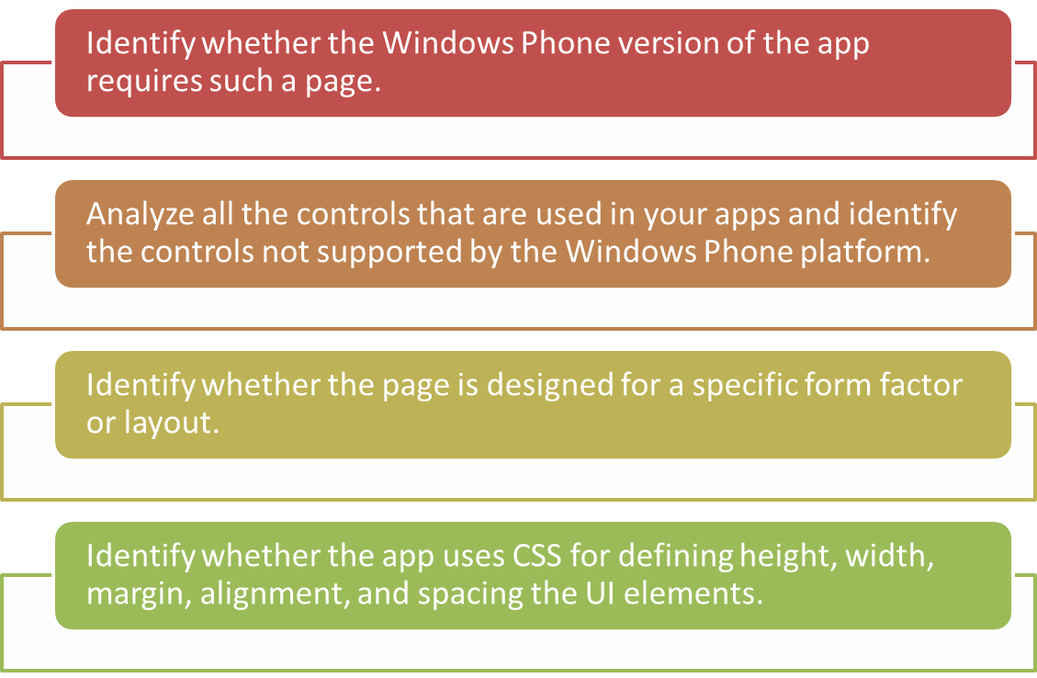
Porting the Windows 8.1 App to Windows Phone 8.1 (Contd.)
The factors that help in determining whether to reuse the Page controls or replace them completely are:

Slide 22
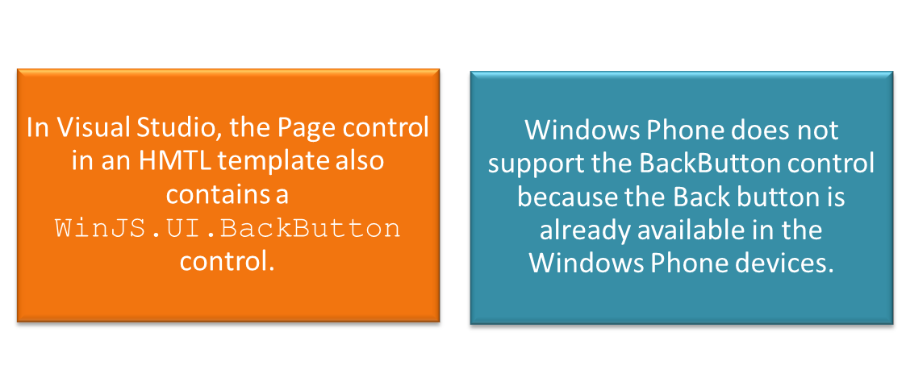
Porting the Windows 8.1 App to Windows Phone 8.1 (Contd.)
If you want to reuse a Page control in your Windows Phone app as is, you need to change the reference with the WinJS Phone libraries:
    <!-- WinJS references -->
    <link href="//Microsoft.Phone.WinJS.2.1/css/ui-dark.css" rel="stylesheet" />
    <script src="//Microsoft.Phone.WinJS.2.1/js/base.js"></script>
    <script src="//Microsoft.Phone.WinJS.2.1/js/ui.js"></script>

Slide 23
Activity 6.3: Porting a Windows Store App to Windows Phone App
Problem Statement:
Lawrence is a Windows Phone developer. He wants to develop a To Do List app that allows users to store a list of tasks they need to perform. Each task should be stored with the task title and the task details. The data stored in the task list should persist across sessions. In addition, if the app is suspended and re-invoked, the values of input fields should not be lost and the users should be able to resume from where they left.
Solution:
To complete this activity, you need to perform the following steps:
  Plan and analyze requirements of the app.
  Create a Windows Phone app by using the Navigation App template.
  Add files and images from the Windows Store app.
  Modify unsupported code sections.
  Execute the app and verify the output.

Slide 24
Summary
In this session, I learned that:

